Slide 1
CMMC/20X
EXECUTIVE PRESENTATION · AUGUST 2026
The Department paused third-party certification. It did not pause the obligation to protect defense information.
A POSITION FROM DEEP FATHOM
Cybersecurity is
not paperwork.
THE POSITION
Keep the Level 2 baseline. Change how it gets verified.
cmmc20x.com
Deep Fathom
01 / 09
Notes:
[Sources]
- https://cmmc20x.com/
- https://cmmc20x.com/about
[/Sources]
Slide 1 of 9
Interpretation boundary: Independent Deep Fathom reform proposal. Not a Government or industry-coalition position.
Public artifact. No private advisor content, customer data, contractor data, CUI, FCI, assessment record, or tracking URL.

Slide 2
CMMC/20X
WHAT CHANGED · JULY 13, 2026
THE POLICY STATE
The certification stopped.
The obligation did not.
Phase II and later milestones were suspended. Existing safeguards, reporting, and current contract duties remain.
Paused
Still in force
Phase II third-party certification
Phase I self-assessment and affirmation
Advancement to later implementation phases
SPRS reporting and DFARS safeguarding duties
WHO DECIDES
The Task Force reviews and recommends. The Department retains policy, rulemaking, and contract authority.
cmmc20x.com
Deep Fathom
02 / 09
Notes:
[Sources]
- https://www.war.gov/News/Releases/Release/Article/4542329/forging-the-arsenal-of-freedom-department-of-war-suspends-cmmc-phase-ii-require/
- https://dowcio.war.gov/Portals/0/Documents/Library/ImplementingSuspensionCMMC-PhaseII.pdf
- https://www.acquisition.gov/dfars/252.204-7012-safeguarding-covered-defense-information-and-cyber-incident-reporting.
[/Sources]
Slide 2 of 9
Interpretation boundary: The Department suspended advancement to Phase II and later milestones. Actual solicitations, contract terms, amendments, and modifications still control each supplier’s duties.
Public artifact. No private advisor content, customer data, contractor data, CUI, FCI, assessment record, or tracking URL.

Slide 3
CMMC/20X
THE COST QUESTION
BUILD · PROVE · VERIFY
Three costs are being counted as one.
Security work remains. Reform can sharply reduce repeated proof and verification work.
WHERE REFORM CAN HELP MOST
01
02
03
Build
Prove
Verify
Controls, architecture, people, remediation, and security operations.
Implementation statements, mappings, sources, updates, and reconciliation.
Assessment, review, and repeated requests for facts that have not changed.
Removing a review step does not implement a safeguard.
Public cost estimates span different scopes; do not subtract them.
cmmc20x.com/blueprint
Deep Fathom
03 / 09
Notes:
[Sources]
- https://www.sba.gov/article/2026/07/13/sba-commends-us-department-wars-suspension-cmmc-phase-ii-small-defense-contractors
- https://www.govinfo.gov/content/pkg/FR-2024-10-15/pdf/2024-22905.pdf
- https://cmmc20x.com/rfi
[/Sources]
Slide 3 of 9
Interpretation boundary: The public estimates measure different scopes and should not be subtracted from one another. Reform can reduce repeated proof and verification work; it does not eliminate implementation or security operations.
Public artifact. No private advisor content, customer data, contractor data, CUI, FCI, assessment record, or tracking URL.

Slide 4
CMMC/20X
THE CMMC 20X POSITION
KEEP THE LEVEL 2 BASELINE
Keep the standard. Change five parts of the work.
Change where security facts come from, how often they are checked, and how often people must re-enter them.
01
Automation over documentation
Collect security facts from the systems that produce them.
02
Continuous over point-in-time
Recheck what changed, when it changed.
Assessment-ready over dashboard green
Preserve source, date, scope, and limits.
03
04
Accessible over enterprise-only
Reach the same baseline without enterprise-scale overhead.
05
Ecosystem-wide over contractor-only
Make responsibility follow the work across organizations.
cmmc20x.com/blueprint
Deep Fathom
04 / 09
Notes:
[Sources]
- https://cmmc20x.com/blueprint
[/Sources]
Slide 4 of 9
Interpretation boundary: The maintained-record lifecycle is proposed reform. Useful policies, plans, diagrams, and assessment records remain necessary when current requirements call for them.
Public artifact. No private advisor content, customer data, contractor data, CUI, FCI, assessment record, or tracking URL.

Slide 5
CMMC/20X
THE MAINTAINED RECORD
THE BLUEPRINT
The security work should produce the proof.
In the proposed model, assessment tests evidence already current. Suppliers maintain the record between reviews.
01
02
03
04
05
06
Scope
Protect
Record
Check
Decide
Update
Name the boundary and owners.
Implement the safeguards.
Keep claims with their sources.
Run repeatable tests.
Record the human finding.
Reopen only affected claims.
Maintain once. Recheck what changes. ↺
Source + date + scope + limitations travel with every claim.
cmmc20x.com/blueprint
Deep Fathom
05 / 09
Notes:
[Sources]
- https://cmmc20x.com/blueprint
- https://cmmc20x.com/research/why-cmmc20x-separates-baseline-evidence-verification
- https://www.ecfr.gov/current/title-32/subtitle-A/chapter-I/subchapter-D/part-170
[/Sources]
Slide 5 of 9
Interpretation boundary: Current evidence, risk-matched review, and explicit decision authority are proposed reform. Current CMMC requirements remain governed by 32 CFR part 170 and applicable contracts.
Public artifact. No private advisor content, customer data, contractor data, CUI, FCI, assessment record, or tracking URL.

Slide 6
CMMC/20X
WORKED EXAMPLE · SYNTHETIC
ONE CLAIM, THREE SOURCES
Use software for repetition. Use people for judgment.
A contradiction stays open until an authorized person judges its scope and consequence.
IA.L2-3.5.3
MFA is enforced for privileged access.
POLICY
IDENTITY EXPORT
LOCAL ACCOUNT
All admins
24 / 24
Outside export
Open
The written rule requires MFA.
Every account in the export shows enforcement.
An emergency access path remains unseen.
Software preserves the conflict.
HUMAN FINDING
A clean export cannot prove an unseen access path.
cmmc20x.com/evidence
Deep Fathom
06 / 09
Notes:
[Sources]
- https://cmmc20x.com/evidence
- https://dowcio.war.gov/Portals/0/Documents/CMMC/AssessmentGuideL2v2.pdf
[/Sources]
Slide 6 of 9
Interpretation boundary: Synthetic evidence example for discussion. Software can preserve sources and draft candidate analysis; qualified people retain findings and authorized decisions.
Public artifact. No private advisor content, customer data, contractor data, CUI, FCI, assessment record, or tracking URL.

Slide 7
CMMC/20X
GRADUATED VERIFICATION · CONDITIONAL MODEL
THE PROPOSAL
Let risk determine the verification route.
Keep the Level 2 safeguards. Replace the binary route with verification depth matched to consequence.
Risk sets the verification route.
Evidence quality triggers sampling, correction, or escalation inside it.
Reopen unchanged
Graduated verification
CUMULATIVE SUPPLIER ATTRITION
36%
97%
3%
90%
suppliers lost
current assurance
suppliers lost
current assurance
CURRENT ASSURANCE IN 2049
Exposure target sustained (12 months ≤ 0.35): Feb. 2031 · reopen unchanged / Feb. 2034 · graduated verification
Medians · 100 paired runs per path · model bf91444e3fcc · conditional results
cmmc20x.com/analysis
Deep Fathom
07 / 09
Notes:
[Sources]
- https://cmmc20x.com/blueprint
- https://cmmc20x.com/research/how-verification-should-scale
- https://cmmc20x.com/analysis
- https://cmmc20x.com/analysis/methodology
- https://www.ecfr.gov/current/title-32/subtitle-A/chapter-I/subchapter-D/part-170
[/Sources]
Slide 7 of 9
Interpretation boundary: Graduated verification is a reform proposal. Current rule, contract, and authorized assessment methods still control.
Public artifact. No private advisor content, customer data, contractor data, CUI, FCI, assessment record, or tracking URL.

Slide 8
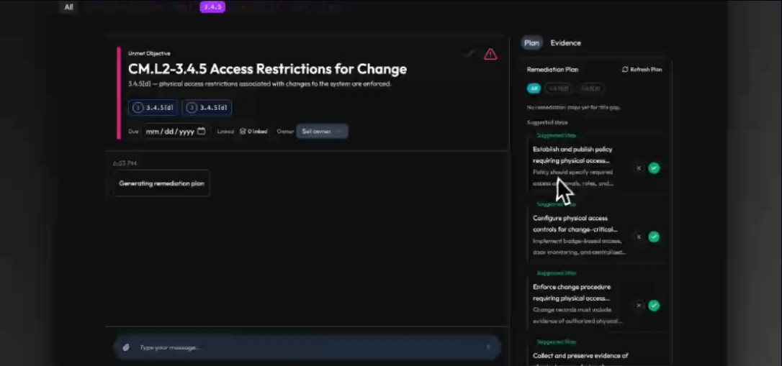
CMMC/20X
THE WORKING IMPLEMENTATION
DEEP FATHOM SOFTWARE
Working software, ready for evaluation.
A working, source-linked implementation spans the Level 2 requirement and assessment-objective set.
110
NIST SP 800-171 Rev. 2 requirements
320
CMMC Level 2 assessment objectives
01
source-linked record behind every generated view
SYNTHETIC DEMONSTRATION WORKSPACE · GUIDED REMEDIATION
READY FOR CONTROLLED EVALUATION
Measure accuracy, disagreement, correction, and reviewer effort on Government-defined cases.
cmmc20x.com/product
Deep Fathom
08 / 09
Notes:
[Sources]
- https://cmmc20x.com/product
- https://cmmc20x.com/evidence
[/Sources]
Slide 8 of 9
Interpretation boundary: Working Deep Fathom software with synthetic demonstration data. The screen does not establish accuracy, burden reduction, Government acceptance, or program effect.
Public artifact. No private advisor content, customer data, contractor data, CUI, FCI, assessment record, or tracking URL.

Slide 9
CMMC/20X
RECOMMENDATIONS FOR DEPARTMENT ACTION
WHAT COMES NEXT
Four recommendations for Department action.
The Task Force can review and recommend. The Department defines the policy, methods, and acceptance conditions.
01
Define graduated verification
02
Define a vendor-neutral evidence profile
Set tiers, risk criteria, reviewers, decision owners, uses, correction, and appeal.
Produce human and machine views from one source, with public conformance tests.
03
Clarify scope and inheritance
04
Charter an independent evaluation
Publish worked examples for boundaries, providers, shared responsibility, and services.
Compare implementations on the same synthetic cases and reference findings.
Keep the baseline. Modernize how it is proved and verified.
cmmc20x.com · cmmc20x@deepfathom.ai
cmmc20x.com
Deep Fathom
09 / 09
Notes:
[Sources]
- https://cmmc20x.com/rfi
- https://cmmc20x.com/evaluation
- https://cmmc20x.com/downloads/cmmc20x-government-pilot-evaluation-charter-v0.1.pdf
[/Sources]
Slide 9 of 9
Interpretation boundary: Proposed vendor-neutral, no-reliance evaluation. Experimental output has no certification, SPRS, award, affirmation, enforcement, supplier-status, or procurement effect.
Public artifact. No private advisor content, customer data, contractor data, CUI, FCI, assessment record, or tracking URL.

